Slide 1


Conhecendo AWS Serverless com CDK, Java e Python
#ptBr
#JoinCommunity2023

Slide 2
Getting to know AWS Serverless with CDK, Java and Python
#en-US
#JoinCommunity2023

Slide 3

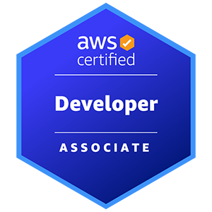
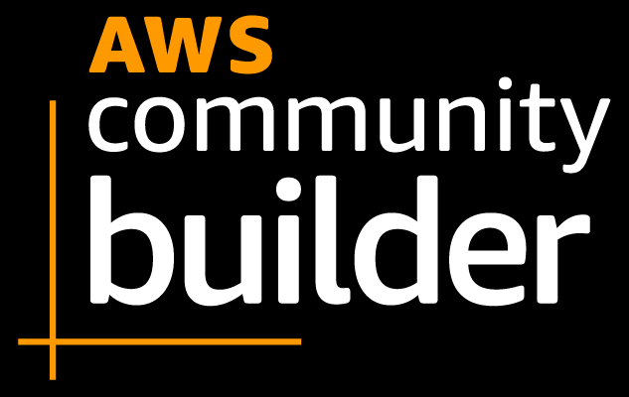




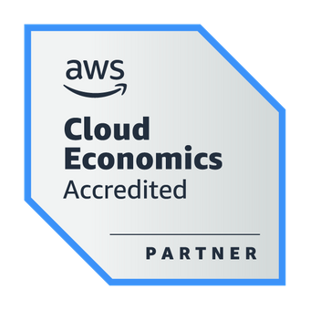
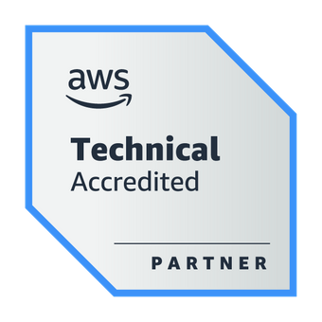
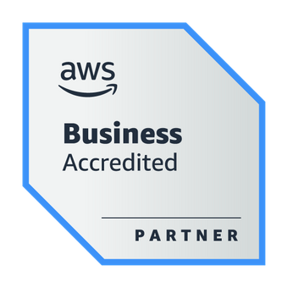

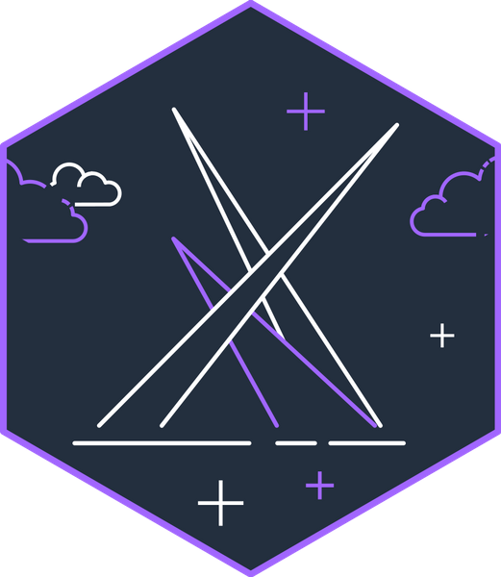
About the Speaker
Weder Mariano de Sousa
Specialist Senior - GFT
Technician System Development
Graduated Computer Science
https://www.linkedin.com/in/wedermarianodesousa/
Post Graduate in Midias UFG
https://github.com/weder96
Post Graduate in Information Security
https://twitter.com/weder96
https://dev.to/weder96
GOJava
AWS User Group Goiânia

Slide 4

Agenda
Question AI
Install AWS Command Line Interface (AWS CLI) Linux
AWS IDE Toolkits
Prerequisites and Tools
Serverless
AWS Storage
AWS Database
AWS API Gateway
AWS Application Integration
AWS Application Orchestration
AWS Lambda Overview
Architecture Serverless
AWS CDK For Java and Python
Next Steps

Slide 5



Question AI
Criar uma rotina de estudo focado na aprendizagem de Serverless AWS ?

Slide 6

ChatGPT
Lembre-se de que a prática é fundamental para o
aprendizado.
À medida que você avança na sua rotina de estudo,
trabalhe em projetos reais para consolidar seus
conhecimentos.
Serverless é uma abordagem poderosa, e dominá-la
pode abrir muitas oportunidades no mundo
da computação em nuvem.
Semana 1-2: Fundamentos da AWS
Semana 3-4: Conceitos Básicos de Serverless
Semana 5-6: Desenvolvimento Serverless
Semana 7-8: Arquitetura e Segurança Serverless
Semana 9-10: Monitoramento e Depuração
Semana 11-12: Serverless Avançado e Projetos
Além da Rotina de Estudo:
Participe de comunidades online relacionadas à AWS e Serverless
para fazer perguntas, compartilhar conhecimentos e aprender
com os outros.
Considere a certificação AWS Certified Developer - Associate
para validar suas habilidades Serverless.
Mantenha-se atualizado lendo blogs, assistindo a webinars e
participando de eventos relacionados à AWS e Serverless.
Nas últimas semanas, vá além dos conceitos básicos:
Serverless Framework: Familiarize-se com o Serverless
Framework para facilitar o desenvolvimento e implantação
de aplicações Serverless.
Projetos Práticos: Comece a criar projetos práticos para
aplicar seus conhecimentos e construir aplicações
Serverless reais.

Slide 7

Bard
Encontre um grupo de estudo. Trabalhar com outras pessoas
pode ajudá-lo a aprender e resolver problemas.
Não tenha medo de pedir ajuda. Se você ficar preso em um conceito,
não tenha medo de procurar ajuda do seu instrutor, de um amigo ou
de um grupo de discussão online.
Semana 1-2: Introdução a Serverless AWS
Semana 3-4: AWS Cognito, AWS CloudWatch AWS CloudFormation
Semana 5-6: Avanços em Serverless AWS Casos de uso de Serverless AWS Projetos de Serverless
Projetos pessoais: Construção de aplicações Serverless AWS
Recursos
Estudo autônomo: Leitura de documentação
Documentação da AWS Tutoriais da AWS
Esta rotina pode ser adaptada de acordo com as necessidades e
objetivos do aluno.
Por exemplo, alunos com experiência em desenvolvimento de
software podem avançar mais rapidamente no conteúdo.
Alunos com menos experiência podem dedicar mais tempo ao
estudo dos conceitos básicos.
Estabeleça metas realistas. Não tente aprender tudo de uma vez.
Comece com os conceitos básicos e avance gradualmente.
Crie um cronograma e cumpra-o. Ter um plano o ajudará a se
manter motivado e no caminho certo.

Slide 8
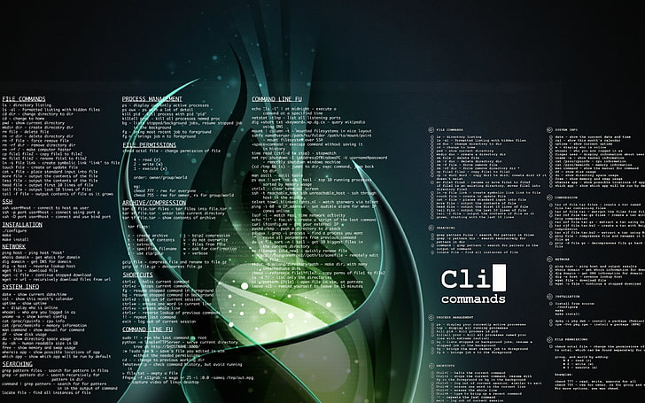

Install AWS Command Line Interface (AWS CLI) Linux

Slide 9
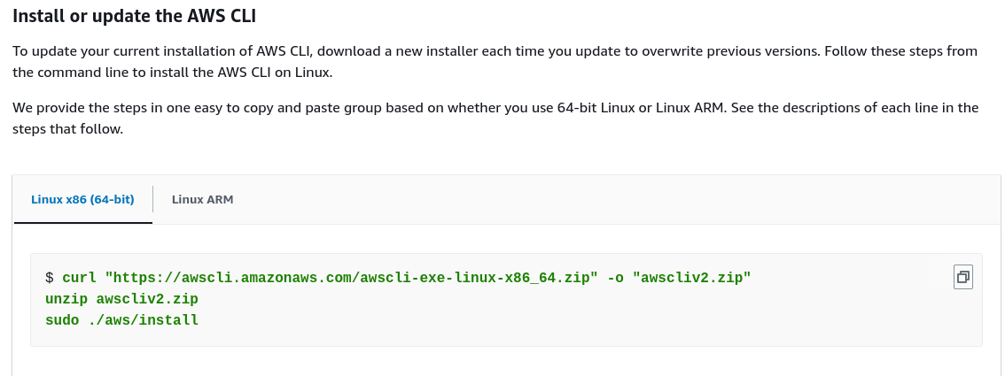
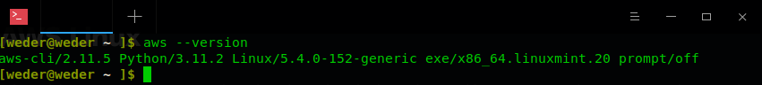
Install AWS Linux
You must be able to extract or "unzip" the downloaded package. if your operating system doesn't have the built-in unzip command, use an equivalent.
The AWS CLI uses glibc, groff, and less. These are included by default in most major distributions of Linux.
We support the AWS CLI on 64-bit versions of recent distributions of CentOS, Fedora, Ubuntu, Amazon Linux 1, Amazon Linux 2 and Linux ARM.
Because AWS doesn't maintain third-party repositories.
We can’t guarantee that they
contain the latest version of the AWS CLI.
https://docs.aws.amazon.com/cli/latest/userguide/getting-started-install.html

Slide 10

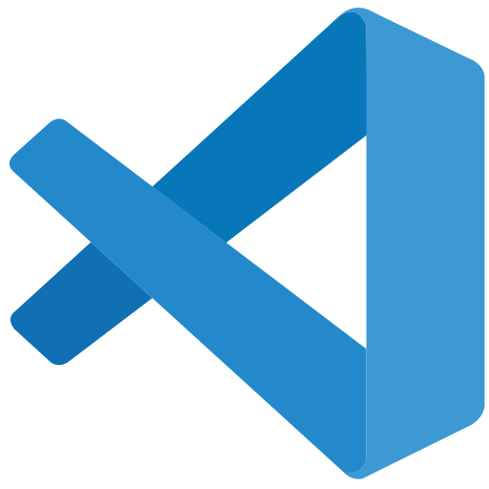

AWS IDE Toolkits

Slide 11
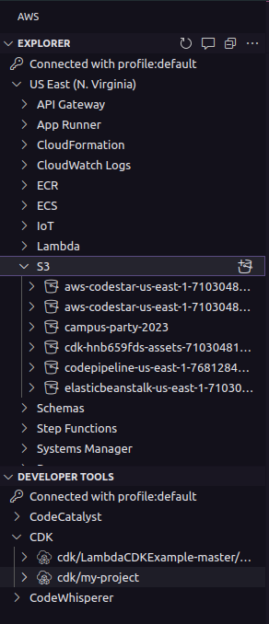
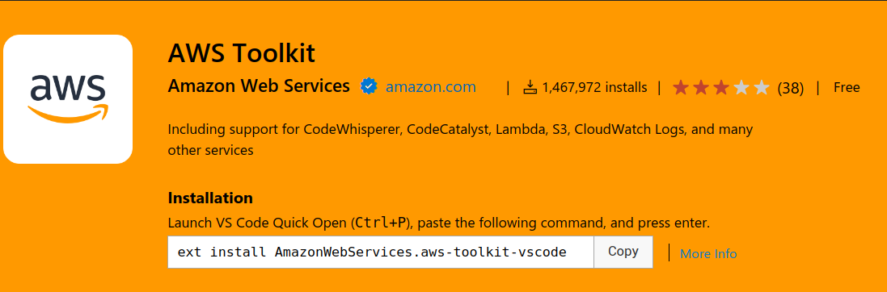
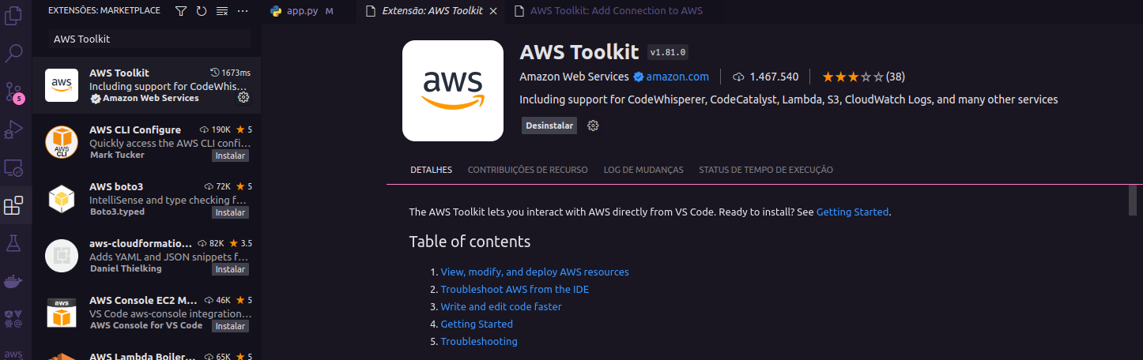
AWS Toolkit for Visual Studio Code
https://aws.amazon.com/serverless/?nc1=h_ls
https://marketplace.visualstudio.com/items?itemName=AmazonWebServices.aws-toolkit-vscode

Slide 12
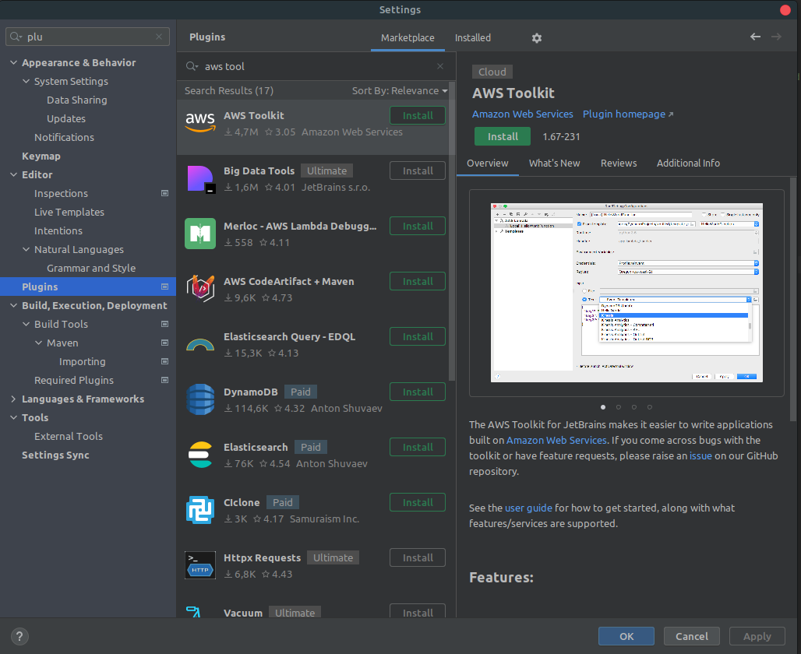

What is Toolkits de IDE da AWS ?

Slide 13
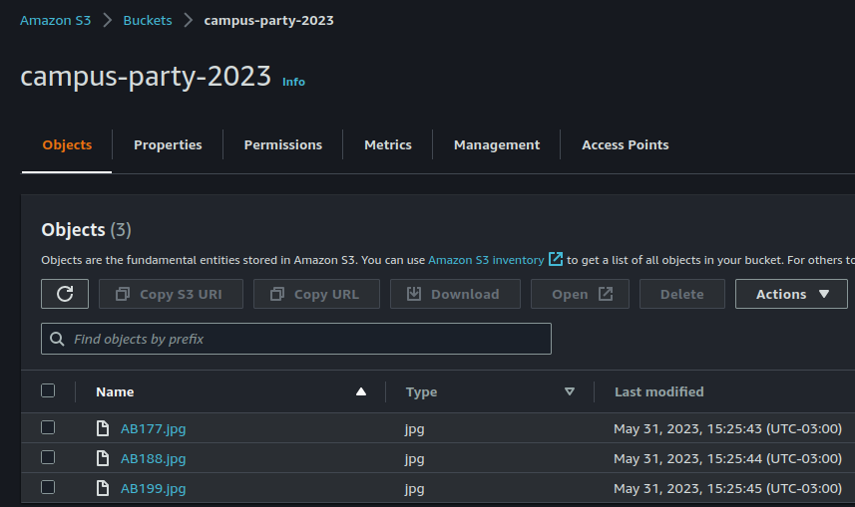
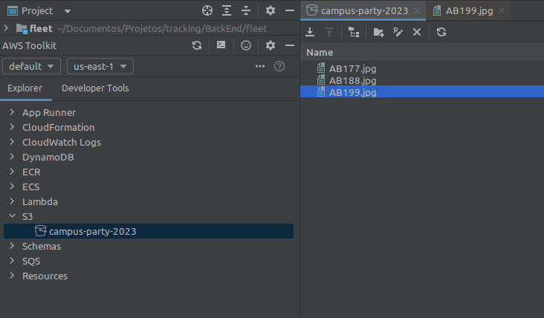
What is Toolkits de IDE da AWS ?

Slide 14

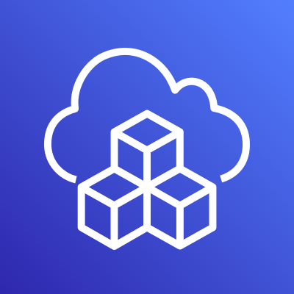
Prerequisites and Tools

Slide 15
Prerequisites and Tools
6 main Prerequisites;
AWS Account and User
AWS CLI
Python 3.10
IDE for your programming language = Visual Studio Code
IDE for your programming language = Intellij IDE
Postman

Slide 16

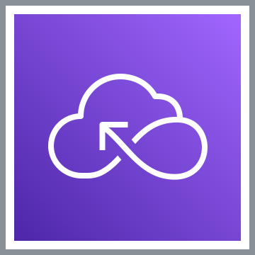
Serverless

Slide 17
What is Serverless ?
Serverless is a way to describe the services that enable you to build and run applications without thinking about servers. AWS has serverless services for all layers of your stack.
In many public forums, like our marketing website, we list these services under the Serverless heading because it improves discoverability.
When it comes to building an architecture diagram, it’s more intuitive to use a functional categorization. Please find the architecture icon for each serverless service in its functional category.
You can use the serverless category icon to describe serverless applications or architectures.
https://aws.amazon.com/serverless/?nc1=h_ls

Slide 18
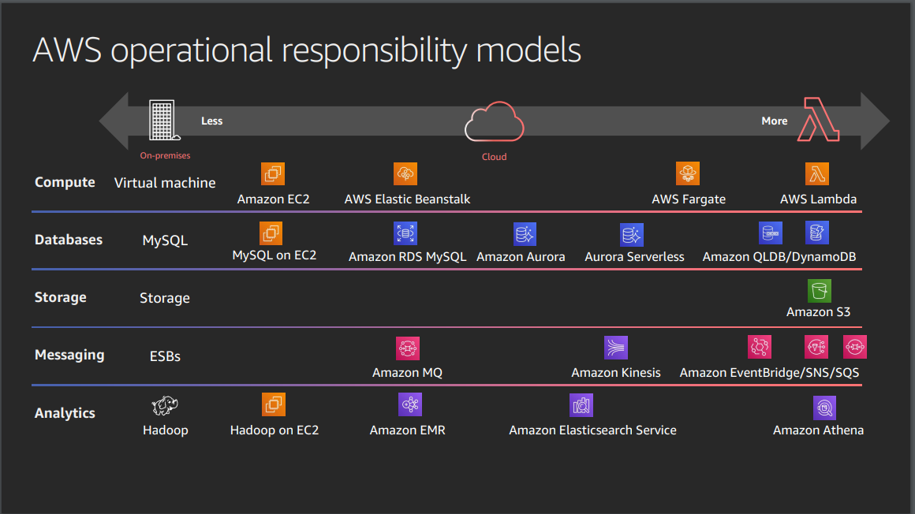
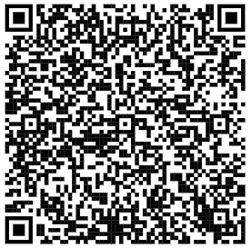
Serverless Explanained : AWS Operational Responsibility Model
https://d1.awsstatic.com/events/reinvent/2019/REPEAT_3_Serverless_architectural_patterns_and_best_practices_ARC307-R3.pdf

Slide 19

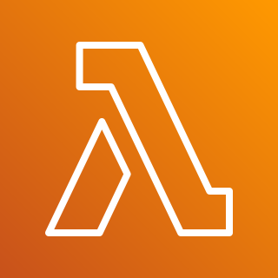
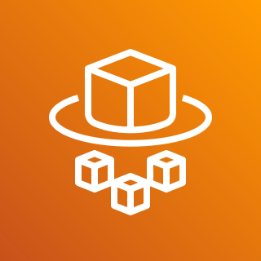


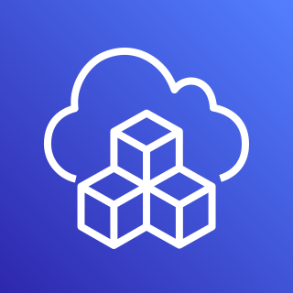


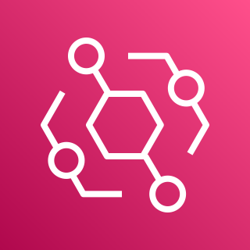

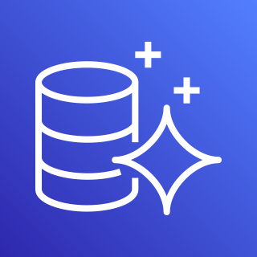
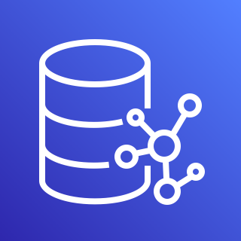
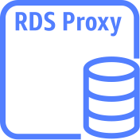
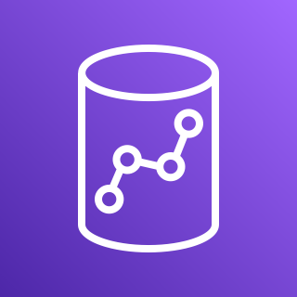

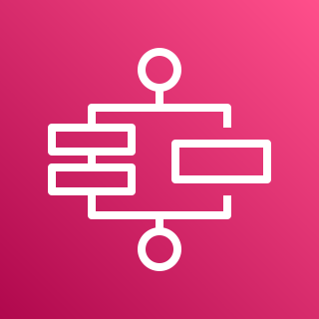


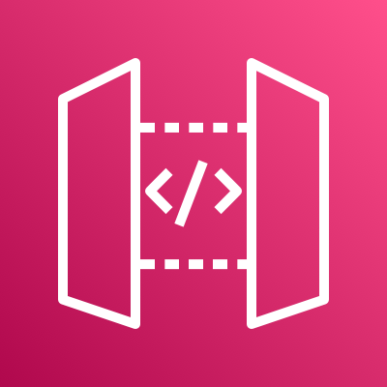
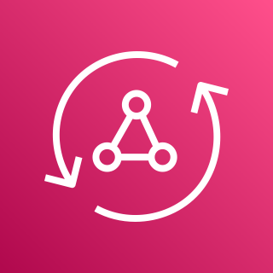

AWS Services Serverless
Compute
Authentication
and Authorization
Serverless Deployment
Frameworks
Application Integrations Services
AWS Lambda
AWS Fargate
Amazon Cognito
AWS CloudFormation
AWS CDK
Amazon
SNS
Amazon
SQS
Amazon
EventBridge
Data Persistence
Research and Analysis
Application Orchestration
DynamoDB
Aurora
Serverless
Neptune
Serverless
RDS
proxy instance
Amazon Redshift
OpenSearch
Service
AWS
Step Functions
Storing & Hosting
Streams
API and AppSync
Amazon S3
Amazon EFS
DynamoDB
Stream
Kinesis Data Streams
Amazon
API Gateway
AWS
AppSync
https://aws.amazon.com/serverless/?nc1=h_ls

Slide 20
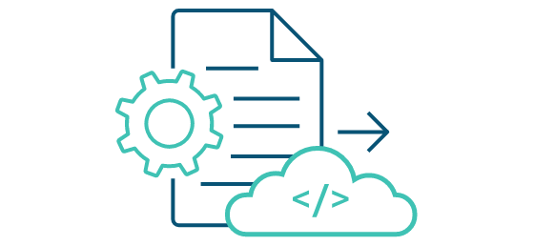


How to build, run and deploy?
When starting designing, and building serverless function, you might wonder how to deploy your function into the cloud. With AWS, there are some ways we can deploy, test and invoke your function:
Using the AWS Console Management: we can create lambda function, upload code, add triggers, and test your Lambda function manually. You might use this way when first.
AWS CLI: you also can use AWS Lambda CLI to create, deploy, invoke, manage, monitor your Lambda function. You can use existing commands to deploy and test your Lambda function automatically without manual process. But this isn’t good for production and large project.
AWS Serverless Application Model (AWS SAM) is an open-source framework for building serverless applications. It provides shorthand syntax to express functions, APIs, databases, and event source mappings.
AWS Cloud Development Kit (AWS CDK) is an open source software development framework to define your cloud application resources using familiar programming languages.
https://aws.amazon.com/serverless/getting-started/?nc=sn&loc=2&serverless.sort-by=item.additionalFields.createdDate&serverless.sort-order=desc

Slide 21
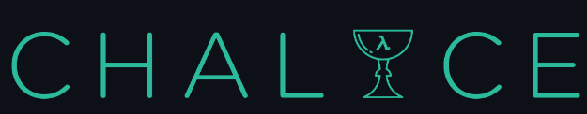

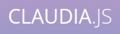
How to build, run and deploy?
Serverless Framework - The Serverless Framework consists of an open source CLI and a hosted dashboard. Together, they provide you with full serverless application lifecycle management.
Chalice is a framework for writing serverless apps in Python. It allows you to quickly create and deploy applications that use AWS Lambda.
Arc.codes provides everything you need to build massively scalable serverless apps with low code, clear and terse config, and zero ceremony.
Claudia.js makes it easy to deploy Node.js projects to AWS Lambda and API Gateway.
https://aws.amazon.com/serverless/getting-started/?nc=sn&loc=2&serverless.sort-by=item.additionalFields.createdDate&serverless.sort-order=desc

Slide 22
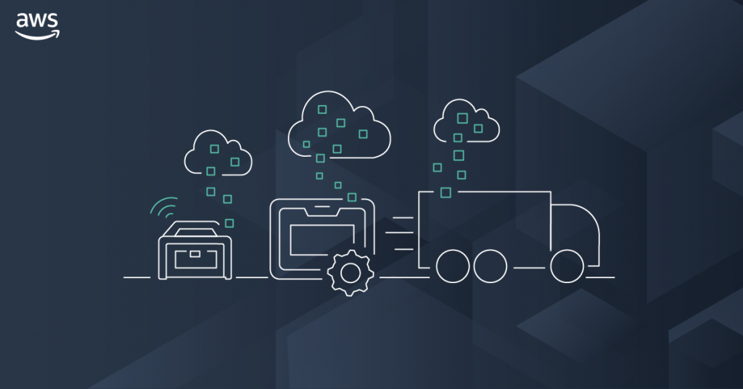
AWS Storage

Slide 23
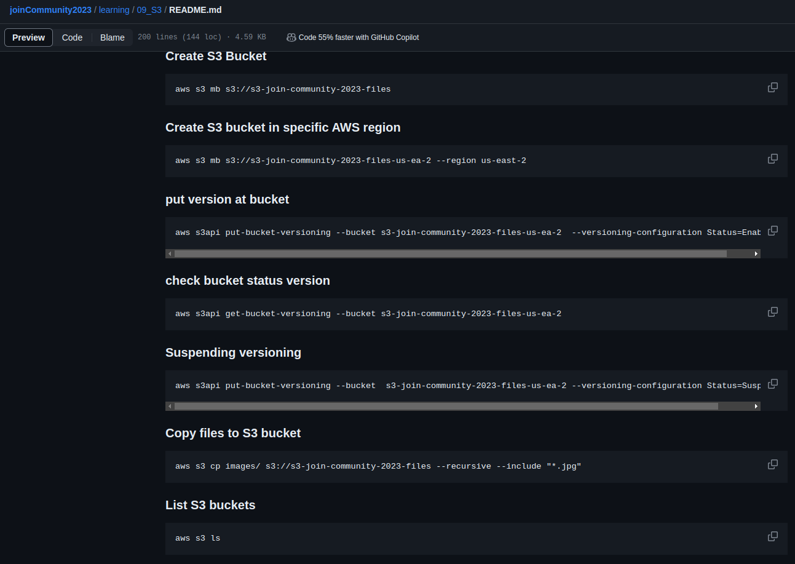
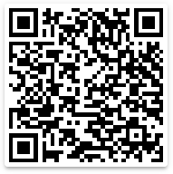
Amazon S3 CLI Commands
Amazon S3
https://github.com/weder96/joinCommunity2023/blob/main/learning/09_S3/README.md

Slide 24
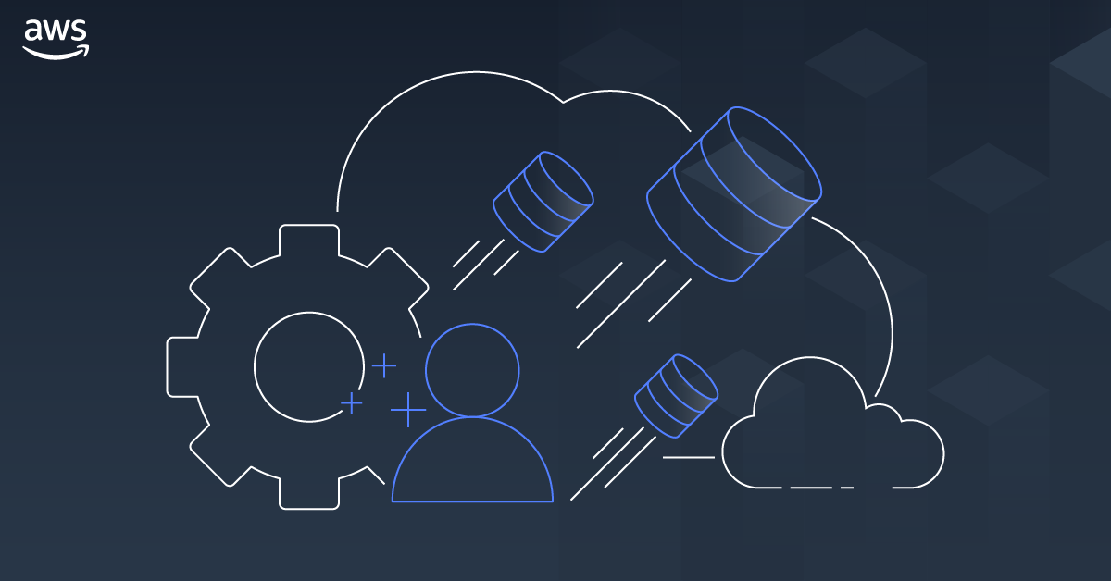
AWS Database

Slide 25
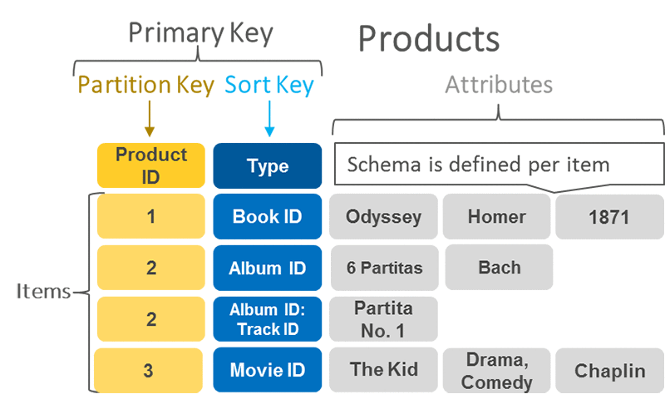
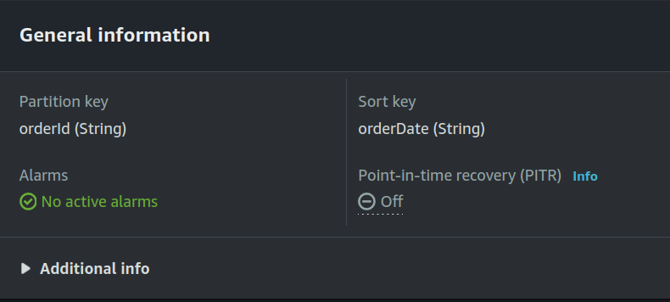
DynamoDB Primary Key, Partition Key and Sort Key
A primary key uniquely identifies each item in the table, so no
two items can have the same key. DynamoDB supports two
different kinds of primary keys:
Partition key
Partition key and sort key
Partition key
A simple primary key, composed of one attribute known as the
partition key.
Partition key and Sort Key
It is Referred to as a composite primary key, this type of key is
composed of two attributes. The first attribute is the partition
key, and the second attribute is the sort key.
DynamoDB uses the partition key value as input to an internal
hash function. A composite primary key gives you additional
flexibility when querying data
https://aws.amazon.com/blogs/database/choosing-the-right-dynamodb-partition-key/

Slide 26
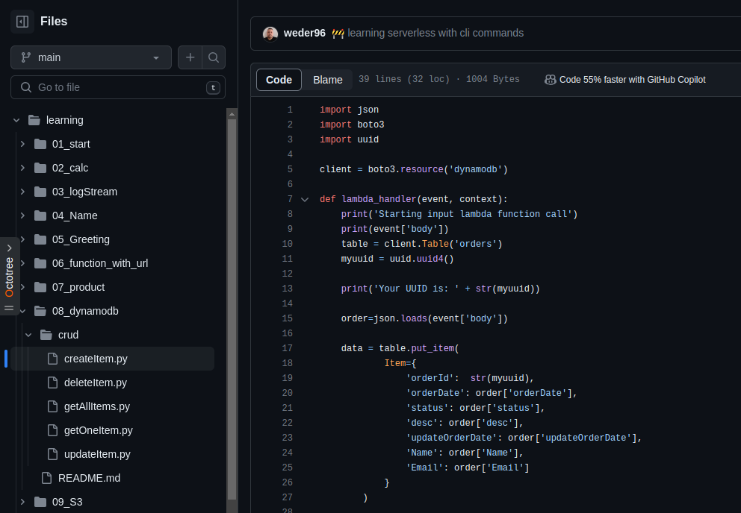
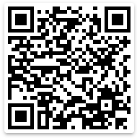
DynamoDB Python(Boto3)
https://github.com/weder96/joinCommunity2023/tree/main/learning/08_dynamodb

Slide 27
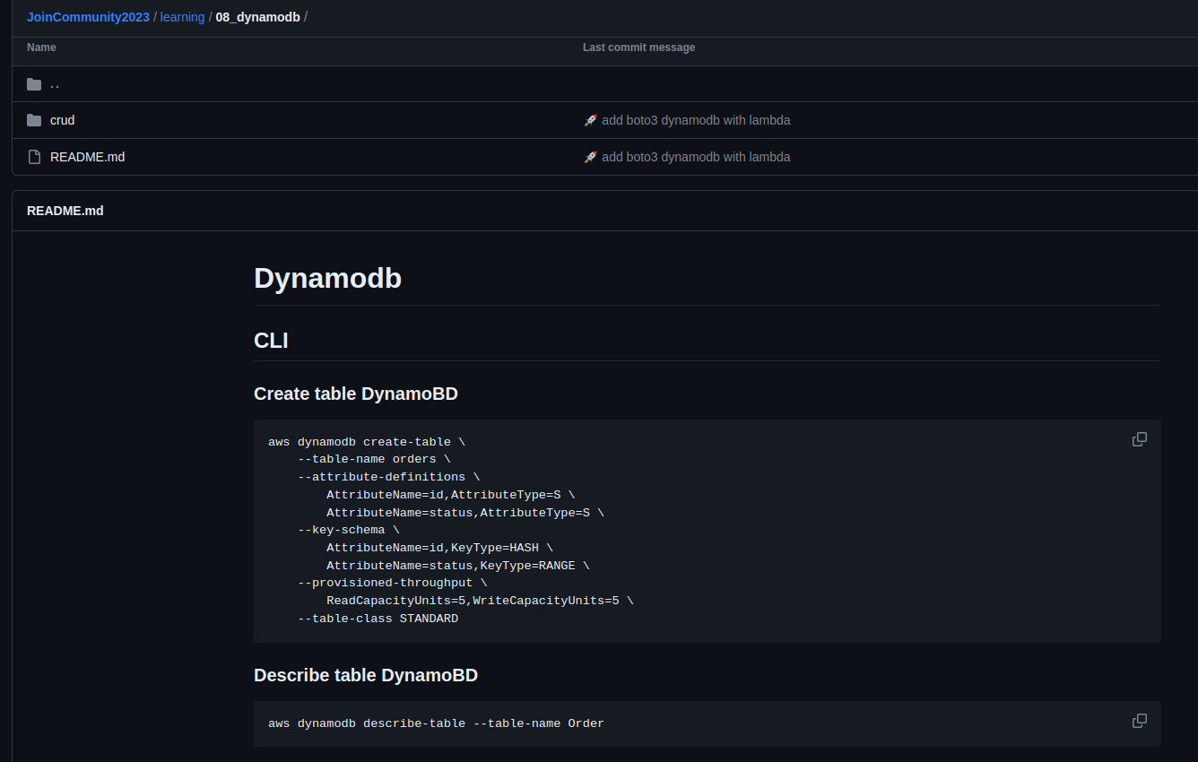
DynamoDB CLI Commands
https://github.com/weder96/joinCommunity2023/tree/main/learning/08_dynamodb

Slide 28
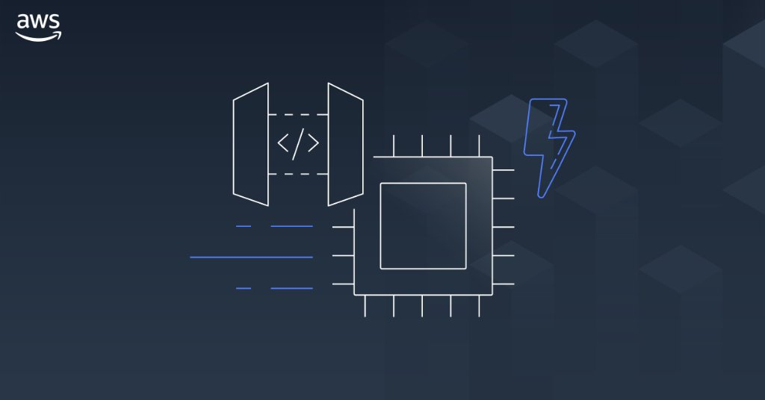
AWS API Gateway

Slide 29
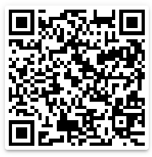
Amazon API Gateway Concepts
API Deployment – a point-in-time snapshot of your API Gateway API resources and methods. To be available for clients to use, the deployment must be associated with one or more API stages.
API endpoints – host names APIs in API Gateway, which are deployed to a specific region and of the format: rest-api-id.execute-api.region.amazonaws.com
API key – An alphanumeric string that API Gateway uses to identify an app developer who uses your API.
API stage – A logical reference to a lifecycle state of your API. API stages are identified by API ID and stage name.
Model – Data schema specifying the data structure of a request or response payload.
Private API – An API that is exposed through interface VPC endpoints and isolated from the public internet
Private integration – An API Gateway integration type for a client to access resources inside a customer’s VPC through a private API endpoint without exposing the resources to the public internet.
Proxy integration – You can set up a proxy integration as an HTTP proxy integration type or a Lambda proxy integration type.
Usage plan – Provides selected API clients with access to one or more deployed APIs. You can use a usage plan to configure throttling and quota limits, which are enforced on individual client API keys.
Amazon
API Gateway
https://github.com/weder96/aws-certification-learning/tree/main/module-5#section-10

Slide 30
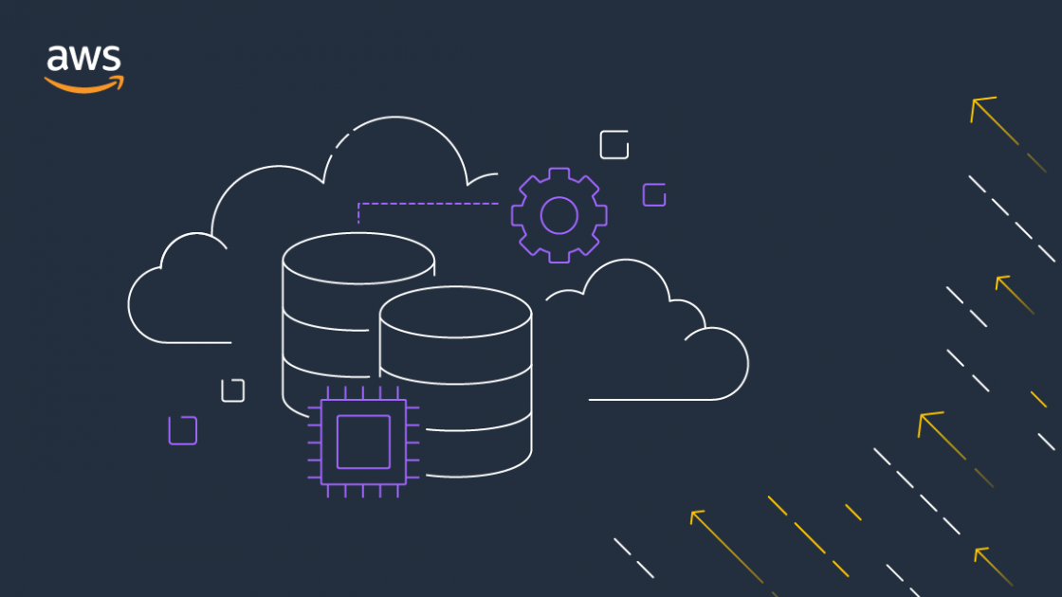

AWS Application Integration
SNS
SQS
EVENTBRIDGE

Slide 31
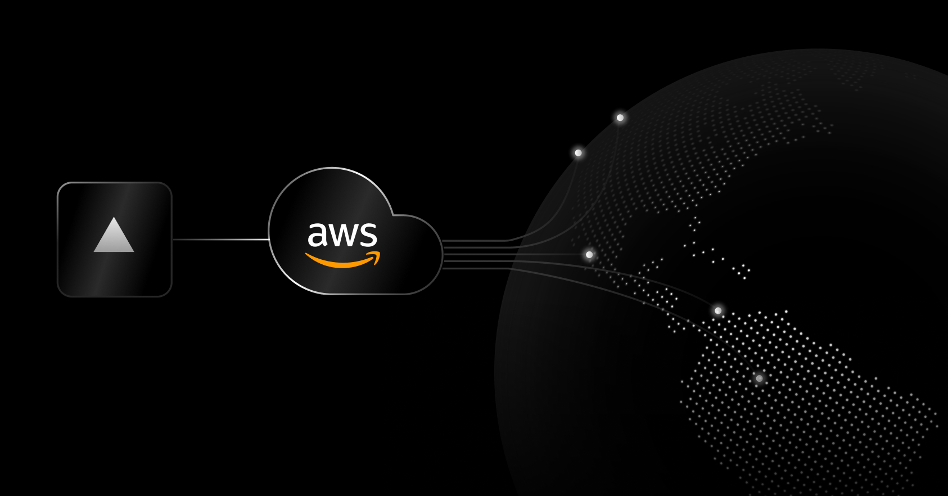
Amazon SNS

Slide 32




Amazon SNS: Fully Managed Pub/Sub Messaging
Application
Integration
Application integration
The Fanout scenario is when a message published to an SNS topic is replicated and pushed to multiple endpoints.
Application alerts
Amazon SNS can send notifications to specified users via SMS and email.
User notifications
Amazon SNS can send push email messages and text messages to individuals or groups.
Mobile push notifications
Mobile push notifications enable you to send
messages directly to mobile apps.
Amazon SNS
Amazon SQS
AWS Lambda
EventType=
Poll-based
Queue
Lambda Function
Messages
1,2,3,....
Topic
EventType=
Poll-based
Queue
Lambda Function

Slide 33
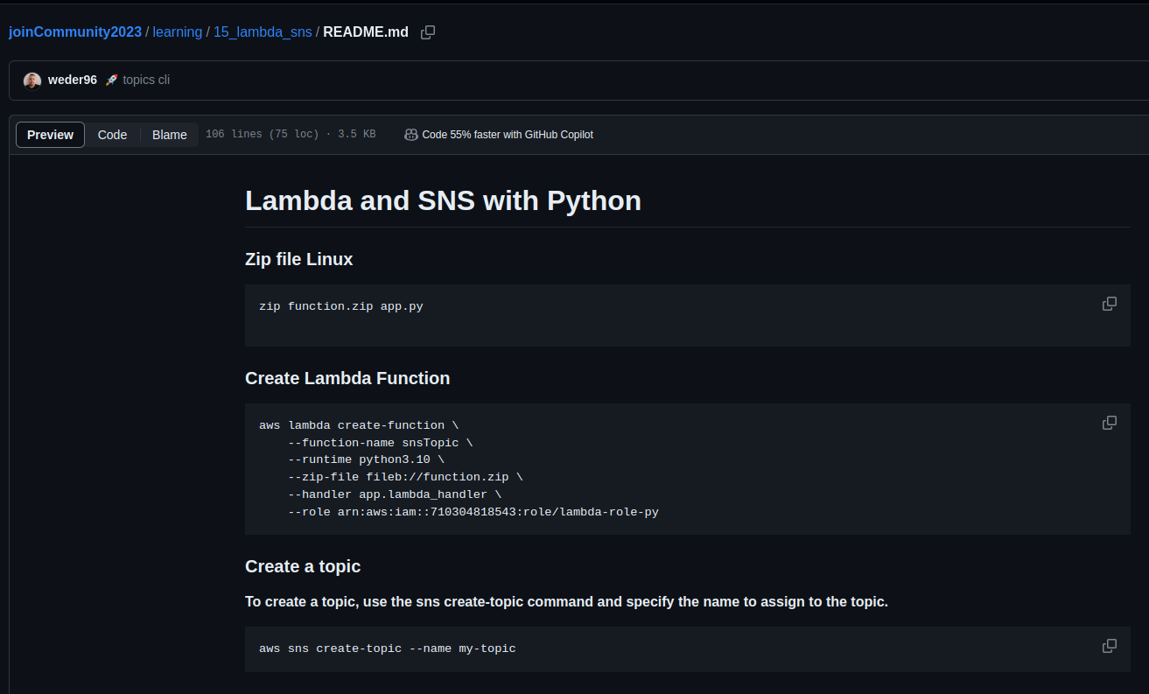
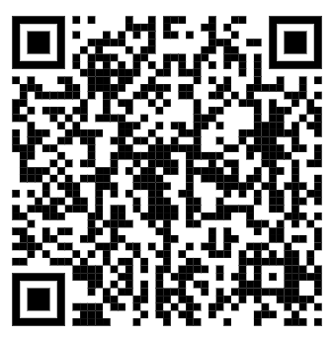
Amazon SNS CLI Commands and (Python) Boto3
Amazon SNS
https://github.com/weder96/joinCommunity2023/blob/main/learning/15_lambda_sns/README.md

Slide 34
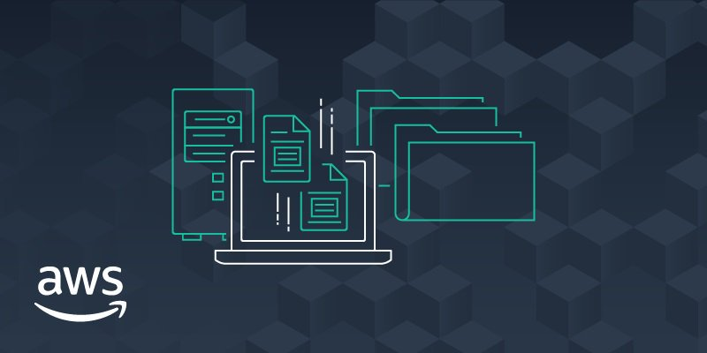
Amazon SQS

Slide 35
What is Amazon SQS ?
Application
Integration
Amazon SQS stands for Simple Queue Service is fully managed message queues for microservices,
distributed systems, and serverless applications.
Enables you to decouple and scale microservices, distributed systems, and serverless applications.
Eliminates the complexity and overhead associated with managing and operating message-oriented
middleware.
Send, store, and receive messages between software components at any volume.
Two types of message queues.
Standard queues offer maximum throughput, best-effort ordering, and at-least-once delivery.
FIFO queues are designed to guarantee that messages are processed exactly once, in the exact order that they are sent.
Integrate and decouple distributed software systems and components.
Provides a generic web services API that you can access using any programming language that the AWS
SDK supports.
Amazon SQS
https://aws.amazon.com/sns/?nc1=h_ls

Slide 36
Amazon SQS What’s a queue?
Application
Integration
Send MEssages
Pool messages
Producer
consumer
Producer
consumer
Queue
consumer
Producer
consumer
Amazon SQS
https://aws.amazon.com/sns/?nc1=h_ls

Slide 37


Amazon SQS CLI Commands and (Python) Boto3
Application
Integration
Amazon SQS
https://github.com/weder96/joinCommunity2023/blob/main/learning/16_lambda_sqs/README.md

Slide 38

Amazon EventBridge

Slide 39

What is Amazon EventBridge ?
Serverless event bus service for AWS services
Build event-driven applications at scale using events generated from your apps
Use to connect your applications with data from a variety of sources, integrated SaaS applications
AWS services to targets such as AWS Lambda functions
Formerly called Amazon CloudWatch Events
https://serverlessland.com/patterns
https://da-public-assets.s3.amazonaws.com/serverlessland/pdf/2021+-+Serverlesspresso+exhibit+-+PDF.pdf

Slide 40

What are events?
An event is defined in JSON
"Detail" is application specific
Envelope attributes are provided by
Amazon EventBridge
Producers create events
Consumers choose which events to
Listen to by using rules
https://da-public-assets.s3.amazonaws.com/serverlessland/pdf/2021+-+Serverlesspresso+exhibit+-+PDF.pdf

Slide 41


Understanding EventBridge target
Does not know about
consumers decoupled
Bus need permissions
to talk to targewt(ex lambda)
Eventbus
rule
target
filter out events
Eventbus
rule
Also knoe as
consumer
Target Example
Lambda
What are target ?
Targets are consumer of you events
use rules to process events before reaching targets
Target Permissions
Your eventBridge bus need permissions
to send events to targets
Serverless Visuals: Small bite sized visuals about Amazon EventBridge David Boyne

Slide 42


Amazon EventBridge CLI Commands and (Python) Boto3
Amazon EventBridge
https://github.com/weder96/joinCommunity2023/blob/main/learning/19_eventbridge/README.md

Slide 43

AWS Application Orchestration
STEP FUNCTIONS

Slide 44

AWS Step Functions

Slide 45












State types
Task
A single unit of work
Choice
Adds branching logic
Parallel
Fork and join the data across tasks
Wait
Delay for a specified time
Fail
Stops an execution and marks it as a failure
Succeed
Stops an execution successfully
Pass
Passes its input to its output
Map
Loop and Foreach

Slide 46


Create a Serverless Workflow with AWS Step Functions and AWS Lambda
https://aws.amazon.com/pt/tutorials/create-a-serverless-workflow-step-functions-lambda/

Slide 47


Amazon Step Functions CLI Commands and (Python) Boto3
AWS Step Functions
https://github.com/weder96/joinCommunity2023/blob/main/learning/21_step_function/README.md

Slide 48

AWS Lambda Overview

Slide 49
AWS Lambda Overview
Serverless on AWS, Build and run applications without thinking about servers
The most popular serverless compute platform that is using millions of customer
Running billions of invocations all over the world
Compute service that runs code without thinking any servers or underlying services
Serverless function that you only responsible for your actual code.
https://aws.amazon.com/serverless/?nc1=h_ls
https://aws.amazon.com/blogs/compute/serverless-icymi-q2-2023/

Slide 50


AWS Lambda Invocation Types
Triggered lambda functions with different AWS Lambda Invocation Types
AWS Lambda has 3 Invocation Types;
Lambda Synchronous invocation
Lambda Asynchronous invocation
Lambda Event Source Mapping with polling invocation
https://aws.amazon.com/blogs/architecture/understanding-the-different-ways-to-invoke-lambda-functions/

Slide 51

Lambda Function Code
AWS Lambda runs instances of your function to process
events.
Invoke function directly using the Lambda API, or
configure an AWS service or resource to invoke your function.
Lambda function has code to process the events
that you pass into the function or that other AWS
services send to the function with event json object.
The event object contains all the information about
the event that triggered this Lambda.
The context object contains info about the runtime
our Lambda function
Return the function with the results

Slide 52



AWS Lambda Execution Role
Resource Based
Policy
Execute Role
Policy
AWS Lambda Permissions
Lambda Execution Role
Resource-based policy
Lambda Execution Role
IAM role that Lambda has permissions to assume when invoking
lambda function.
Create an execution role when creating a new lambda function, and
after that we can also modify the policies associated with the IAM role.
if you have additional targets from your lambda function
performing crud operations on DynamoDB table
sending notification to SNS
retrieve messages from queue or streams
Lambda function's execution role required permissions to
interact with those AWS services
Grant least privilege access to your Lambda execution role
Who can Invoke
Lambda ?
Who can interact
Lambda Invoke ?
AWS Lambda
https://docs.aws.amazon.com/lambda/latest/dg/lambda-intro-execution-role.html

Slide 53

AWS Lambda Resource-based Policy
Lambda Resource-based policy
When any AWS service invokes Lambda function sync or async way. It lets you grant usage permission to other AWS accounts or organizations on a per-resource basis. Also use a resource-based policy to allow an AWS service to invoke your function on your behalf.
API Gateway that targets to Lambda function, we should add resource-based policy permission to invoke
lambda function from API gateway.
Amazon S3 upload event triggers to lambda function asyncrhously, so we should also add Resource-based policy into our Lambda function grants S3 invocation.
Resource Based
Policy
Execute Role
Policy
Amazon SNS
DynamoDB
Amazon
API Gateway
allow
sns.amazon.com
Lambda:
InvokeFunction
allow
Dynamodb: PutItem
logs: PutLogs
AWS Lambda
Amazon CloudWatch
Amazon S3
https://docs.aws.amazon.com/lambda/latest/dg/lambda-intro-execution-role.html

Slide 54

Architecture
Serverless

Slide 55

Amazon SNS with AWS Management Console
AWS Cloud
Command CLI
Create
User
topic
Topic
AWS Command Line Interface (AWS CLI)
Amazon Simple Notification Service (Amazon SNS)

Slide 56
Amazon SQS Queue Polling From AWS Lambda
AWS Cloud
Send /Messages
EventType =
Poll-based
User
Queue
Lambda
function
Amazon Simple Queue Service (Amazon SQS)
Event Filter
AWS Lambda

Slide 57

Microservices “REST”
AWS Cloud
service1.example.com
Amazon API Gateway
AWS Lambda
Amazon DynamoDB
microservice1
Client
AWS Cloud
service2.example.com
Amazon API Gateway
AWS Lambda
Amazon DynamoDB
microservice2

Slide 58



Build Serverless Chat App with a WebSocket API and Lambda
AWS Cloud
$connect route
$default route
WSS
send Message
route
Users
WebSocket
API
Amazon DynamoDB
{
"action": "sendMessage",
"message": "Hello from websocket !"
}
$disconnect
route
Lambda function
https://docs.aws.amazon.com/apigateway/latest/developerguide/websocket-api-chat-app.html

Slide 59

Secure your API Gateway with Amazon Cognito User Pools
AWS Cloud
Authenticate
token
Amazon Cognito
Verify token
Client
HTTP Call
with token
Amazon API
Gateway
AWS Lambda
Amazon DynamoDB

Slide 60




Using an Amazon S3 trigger to invoke a Lambda function
AWS Cloud
Amazon S3
AWS Lambda
Amazon CloudWatch
Permissions policy
Upload Object
in bucket
Bucket with
objects
Lambda function
Logs
Client
https://docs.aws.amazon.com/lambda/latest/dg/with-s3-example.html

Slide 61
AWS Lambda Destination to SQS - DLQ Case
AWS Cloud
Amazon S3
AWS Lambda
Amazon SQS
Permissions policy
Upload Object
in bucket
Bucket with
objects
Lambda function
Queue
Client
https://docs.aws.amazon.com/lambda/latest/dg/with-s3-example.html

Slide 62

Using an Amazon SNS to send message to Lambda function
AWS Cloud
Amazon SNS
AWS Lambda
Amazon CloudWatch
Permissions policy
CLI - Command
line Interface
Amazon SNS
Standart Topic
Lambda function
CloudWatch
Logs
Client
https://docs.aws.amazon.com/lambda/latest/dg/with-sns-example.html

Slide 63




Processing performance with Amazon Kinesis Data Streams and AWS Lambda
Front Ends
AWS Cloud
AWS Lambda functions
Client
Bucket S3
Mobile client
Insert Item
Amazon
DynamoDB Table
Amazon Kinesis Data Streams
Traditional server
Amazon Kinesis Data Streams
Users
https://aws.amazon.com/blogs/compute/increasing-real-time-stream-processing-performance-with-amazon-kinesis-data-streams-enhanced-fan-out-and-aws-lambda/

Slide 64

Command, Publish, Consume, Query (CPCQ)
AWS Cloud
User
AWS Lambda
(Command)
Amazon DynamoDB
(DB)
AWS Lambda
(publish)
microservice1
Amazon EventBridge
AWS Cloud
User
AWS Lambda
(query)
Amazon DynamoDB
(DB)
AWS Lambda
(Consumer)
microservice2

Slide 65

Event hub
Producer
Event Hub
Consumer
hub
stream
AWS Lambda
EventBridge
Amazon
Kinesis
AWS Lambda
Event Lake
Amazon S3
OpenSearch

Slide 66


Saga Pattern For Orchestrate Distributed Transaction (AWS StepFunctions)
AWS Cloud
Order Orchestrate
Client
Fail
/order
x-api-key
100 RPS
50 burst
Order
Table(Orders)
API Gateway
Microservice
Is Success
Fail
Remove Order
Inventory
Table(Inventory)
Microservice
Is Success
Fail
Revert Inventory
Payment
Table(Payment)
Microservice
Is Success
Fail
Revert Payment
Amazon CloudWatch
Success

Slide 67


Circuit Breaker and Many More by Jeremy Daly
AWS Cloud
Increment Failure Count
ElastiCache
open
Status?
close
Third Party API
User
Amazon API
Gateway
AWS Lambda
half open(fail)
half open(try)

Slide 68

Fan-Out Serverless Architectures Using SNS, SQS and Lambda
AWS Cloud
EventType=
Poll-based
Queue
Amazon SQS
Notification
Client
publish
Message
EventType=
Poll-based
x-api-key
100 RPS
50 burst
Queue
API Gateway
(Rest)
AWS Lambda
(Order Microservice)
Amazon SNS
Amazon SQS
Inventory
EventFilter
EventType=
Poll-based
Queue
Amazon DynamoDB
(Order Table)
Amazon SQS
Shipment
Amazon CloudWatch
Stack
AWS CloudFormation and CDK

Slide 69


Joot’s Serverless Architecture (Joot uses for image processing)
https://www.serverless.com/blog/serverless-architecture

Slide 70



AWS CDK for Java and Python

Slide 71

What is AWS CDK?
The AWS Cloud Development Kit (AWS CDK) is an open-source software development framework for defining cloud infrastructure as code(IAC) with modern programming languages and deploying it through AWS CloudFormation.
https://aws.amazon.com/cdk/faqs/
https://aws.amazon.com/cdk/?nc1=h_ls

Slide 72



Demo CDK
Clone S3 AWS with CDK
https://github.com/weder96/aws-image-upload-wsousa
https://github.com/weder96/presentationCampusParty2022

Slide 73

CDK Lifecycle

Slide 74
CDK Code Structure
Apps
Stacks
Construct
Construct
Stack(DEV)
Construct
Construct
Construct
APP
Stack(UAT)
Construct
Construct
Stack(PRD)
Construct
Executable program
Used to render and deploy
cfn templates
Deployable unit
Knows about region and account
Construct
Representations of AWS resources
Can form a hierarchical tree structure

Slide 75

Proof of Concepts AWS CDK - CRUD
AWS Cloud
create
sdk(Boto3)
Users
POST
API Gateway
EndPoint
Lambda
function
Amazon
API Gateway
update
sdk(Boto3)
PATCH
API Gateway
EndPoint
Lambda
function
get All
sdk(Boto3)
GET
API Gateway
EndPoint
Lambda
function
DynamoDB
Table
(orders)
get By Id
sdk(Boto3)
GET
API Gateway
EndPoint
Lambda
function
delete
sdk(Boto3)
Stack
DELETE
API Gateway
EndPoint
Lambda
function
AWS CloudFormation
Amazon CloudWatch
https://github.com/weder96/poc-cd1k-java

Slide 76


Proof of Concepts AWS CDK
The purpose of this PoC is to understand how to use the CDK to generate the infra(JAVA) of a CRUD(Create, Read, Update, Delete) using , API Gateway, lambdas(Python) and DynamoDB, its advantages and limitations of traditional use with the creation of a Cloudformation(SAM) template.
https://github.com/weder96/poc-cdk-java

Slide 77



Prerequisites for Installing AWS CDK
Before you can dive into the world of AWS CDK, you need to take care of a couple of prerequisites. First, ensure you have Node.js version 18.0.0 or later installed on your system.
Installing AWS CDK
Installing the AWS CDK is a breeze. Run the following command in your terminal or command prompt to install AWS CDK:
Verifying AWS CDK Installation
https://hands-on.cloud/install-aws-cdk-guide/

Slide 78


Initializing a CDK Project
,
To initialize a new CDK project, navigate to the desired directory in your terminal or command prompt and run the cdk init command with the appropriate template and programming language. For example, to create a Java-based CDK project, you would run the following command:
https://hands-on.cloud/install-aws-cdk-guide/

Slide 79


Building and Deploying Your AWS CDK App
Once your CDK project is set up, the next step is to build and deploy your AWS CDK app.
This process involves synthesizing CloudFormation templates in YAML format, saving them in the cdk.out folder as JSON, bootstrapping your stack, and deploying your app to your AWS account.
By following these steps, you can create and manage your AWS infrastructure using the power of AWS CDK and your preferred programming language.
cdk synth
To synthesize CloudFormation templates for your AWS CDK app, run the cdk synth command in your terminal or command prompt. This command generates YAML-formatted CloudFormation templates for each stack in your app, encompassing all the resources you’ve defined in your CDK code.

Slide 80

Bootstrapping AWS CDK
Before deploying your AWS CDK app, you’ll need to bootstrap your stack. Bootstrapping involves creating dedicated Amazon S3 buckets and other containers required for deploying your app using AWS CloudFormation.
To bootstrap your stack, run the cdk bootstrap command in your terminal or command prompt. This command deploys a CDKToolkit CloudFormation stack into the specified environment, provisioning the necessary resources for your AWS CDK app.
cdk bootstrap

Slide 81

Deploying the App
You’re ready to deploy your AWS CDK app with your synthesized CloudFormation templates and bootstrapped stack. To do this, run the cdk deploy command in your terminal or command prompt.
cdk deploy
This command deploys your CDK app to your AWS account, creating and updating the necessary AWS resources as defined in your CloudFormation templates. Once the deployment is complete, you can monitor and manage your deployed resources using the AWS Management Console or AWS CLI.

Slide 82


Deploying the App
aws resources being created by the deploy command, using the template created in the synth command
After creating it, it shows the time it was created and whether it managed to create all the necessary resources

Slide 83

Destroy the App
When you no longer need certain resources in your AWS CDK app, you can destroy them using the cdk destroy command. This command deletes the specified stack and all its associated resources unless they have been marked with a Deletion Policy to be retained.
cdk destroy

Slide 84

Diff the App
When you have made changes to your infrastructure code by adding or removing certain resources in your AWS CDK application, you can use the cdk diff command. This command will show what has been modified and which resources will be created and will be listed for monitoring.
cdk diff

Slide 85


Code Lambda with Python
The AWS SDK for Python (Boto3) provides a Python API for AWS infrastructure services.
Using the SDK for Python, you can build applications on top of Amazon S3, Amazon EC2, Amazon DynamoDB, and more.

Slide 86


Code IAC(infrastructure as Code)
In this case we are generating the infrastructure using the AWS SDK, however the code controller is written in Java, using the CDK it generates the Cloudformation template, which is then deployed creating the services automatically in AWS in your account configured in your machine via credentials.

Slide 87

Code IAC (infrastructure as Code)
Create Lambda Role

Slide 88



Code IAC (infrastructure as Code)
Create DynamoBD and Grant Permissions Lambda Functions

Slide 89




Code IAC (infrastructure as Code)
Reading Lambda Functions

Slide 90


Code IAC (infrastructure as Code) - Create API Gateway

Slide 91


Postman Call API Gateway

Slide 92

Postman Call API Gateway

Slide 93

Postman Call API Gateway

Slide 94

Postman Call API Gateway

Slide 95

Postman Call API Gateway

Slide 96


Lambda Function Python(Boto3) - Create Item

Slide 97

Lambda Function Python(Boto3) - Update Item

Slide 98

Lambda Function Python(Boto3) - Get All Item

Slide 99

Lambda Function Python(Boto3) - Get One Item By Id

Slide 100

Lambda Function Python(Boto3) - Delete Item By Id

Slide 101

AWS Resources (API Gateway) create(GET)

Slide 102

AWS Resources (API Gateway) create (POST)

Slide 103

AWS Resources (API Gateway) create /id (DELETE)

Slide 104

AWS Resources (API Gateway) create /id (GET)

Slide 105

AWS Resources (API Gateway) create /id (PATCH)

Slide 106

AWS Resources create (Lambdas)

Slide 107


AWS Resources create (DynamoDB)

Slide 108

AWS Resources create (IAM Role)

Slide 109

Next Steps

Slide 110


The AWS Step Functions Workshop
https://catalog.workshops.aws/stepfunctions/en-US

Slide 111


AWS Serverless Digital Learning Badges
AWS Skill Builder
https://aws.amazon.com/blogs/compute/introducing-new-aws-serverless-digital-learning-badges/

Slide 112


Want to Try?
Serverless Security Workshop
https://catalog.us-east-1.prod.workshops.aws/workshops/026f84fd-f589-4a59-a4d1-81dc543fcd30/en-US

Slide 113


Want to Try?
Serverland AWS Lambda Fundamentals
https://s12d.com/lambda-fundamentals

Slide 114


Want to Try?
Serverless airline – Multiple patterns/practices
https://github.com/aws-samples/aws-serverless-airline-booking

Slide 115


Want to Try?
CDK - Workshop
https://cdkworkshop.com/

Slide 116


Want to Try?
CDK Patterns
https://cdkpatterns.com/

Slide 117


Want to Try?
handson.cloud
https://hands-on.cloud/

Slide 118
Resources
https://cdkworkshop.com
https://github.com/aws-samples/aws-cdk-examples
https://docs.aws.amazon.com/cli/latest/userguide/getting-started-install.html
https://aws.amazon.com/pt/developer/language/java/
https://docs.aws.amazon.com/toolkit-for-jetbrains/latest/userguide/setup-toolkit.html
https://aws.amazon.com/pt/intellij/
https://docs.aws.amazon.com/code-library/latest/ug/java_2_code_examples.html
https://docs.aws.amazon.com/pt_br/prescriptive-guidance/latest/patterns/deploy-a-ci-cd-pipeline-for-java-microservices-on-amazon-ecs.html
https://docs.aws.amazon.com/lambda/latest/dg/lambda-java.html
https://aws.amazon.com/pt/blogs/compute/java-17-runtime-now-available-on-aws-lambda/
https://www.slideshare.net/AmazonWebServices/java-on-aws
https://www.jrebel.com/blog/aws-java-application-setup
https://www.slideshare.net/VadymKazulkin/adopting-java-for-the-serverless-world-at-jax-2022
https://towardsaws.com/deploy-spring-boot-application-to-aws-ec2-using-docker-f359e7ad2026
https://aws.amazon.com/pt/blogs/developer/stepfunctions-fluent-api/
https://aws.amazon.com/blogs/compute/java-17-runtime-now-available-on-aws-lambda/
https://docs.aws.amazon.com/lambda/latest/dg/snapstart.html

Slide 119
About the Speaker
Q & A
Weder Mariano de Sousa
Specialist Senior - GFT
Technician System Development
Graduated Computer Science
https://www.linkedin.com/in/wedermarianodesousa/
Post Graduate in Midias UFG
https://github.com/weder96
Post Graduate in Information Security
https://twitter.com/weder96
https://dev.to/weder96
GOJava
AWS User Group Goiânia

Slide 120
THANK YOU

